Slide 1
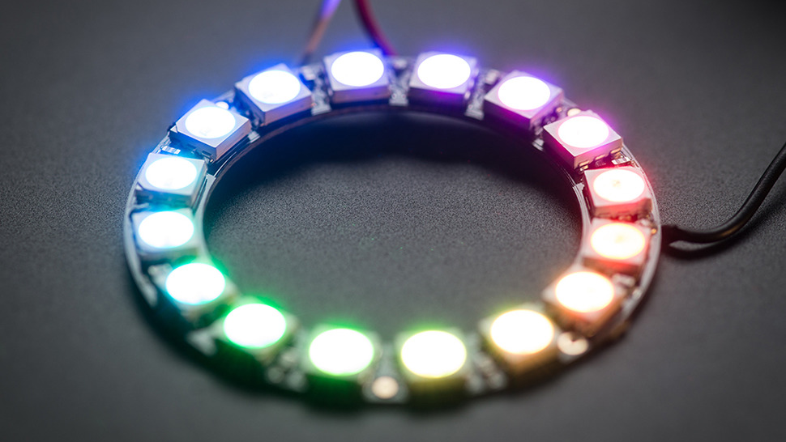
Raspberry Lites
Team Members:
Jeron Clarke
Genesis Knight
Ricardo Calderon

Slide 2
What Is Tap?
TAP
TAP stands for Technology Ambassador Program
TAP is funded by the STARS organization which is a computing corporation that provides training, resources, and community for broadening participation in computing.
Goals
Increasing the number of students who persist in an IT major or minor, particularly those underrepresented in the computing field.

Slide 3


Goals
Our project is tailored for students k-12 that are curious or aspiring to be IT professionals.
We Want our project to demonstrate the collaborative impact of using different technologies together to achieve a common goal.

Slide 4
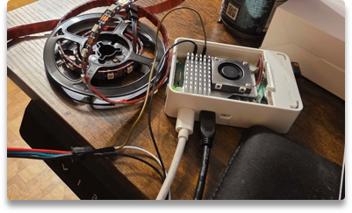
Raspberry Lites
What are we doing?
What technology are we using?
What are we teaching?
We want to create a real-life lightshow with the use of Python computer language to demonstrate how programming has more utilization that just software and web applications.
The technology being used are:
Minicomputer called a Raspberry Pi
USB mouse and keyboard
Python programming language
Addressable LED strips.
We want to educate the use of functions and algorithms in our code and how they can be used for creating our own unique light show.

Slide 5
Algorithms?...
THINK OF THE WAY YOU MAKE YOUR BREAKFAST.
WHAT STEPS DO YOU TAKE TO GET SOMETHING TO EAT?
DO YOU POUR THE CEREAL FIRST OR THE MILK FIRST?
THERE IS NO WRONG ANSWER. ALGORITHMS are the set of instructions used to complete a task.
Programming works the same way because code is usually interpreted line by line.

Slide 6
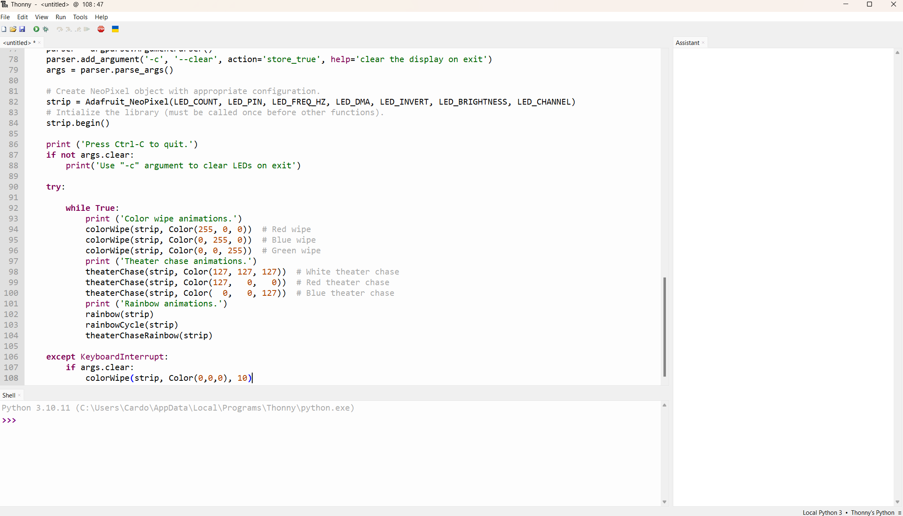
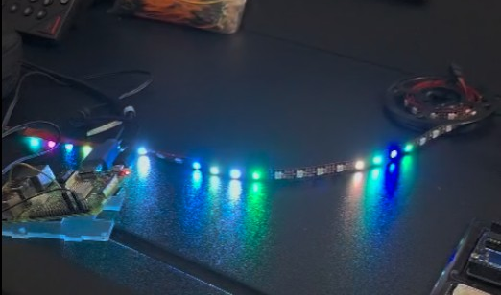
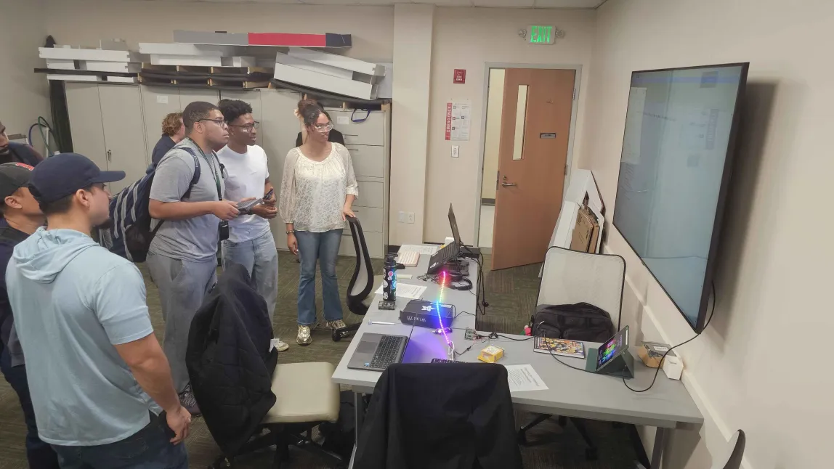
Raspberry Lites Workshop
Check out the code!
Get Creative
Execute the code!
Students will get to see the inner workings of the Python code and get to ask questions about how it works.
They can then interact with the graphical interface to work on their own algorithms.
After the students create their own functions on the Python script, they will get to execute the code and see the different colored lights that their code creates.

Slide 7
Let's get in groups!

Slide 8
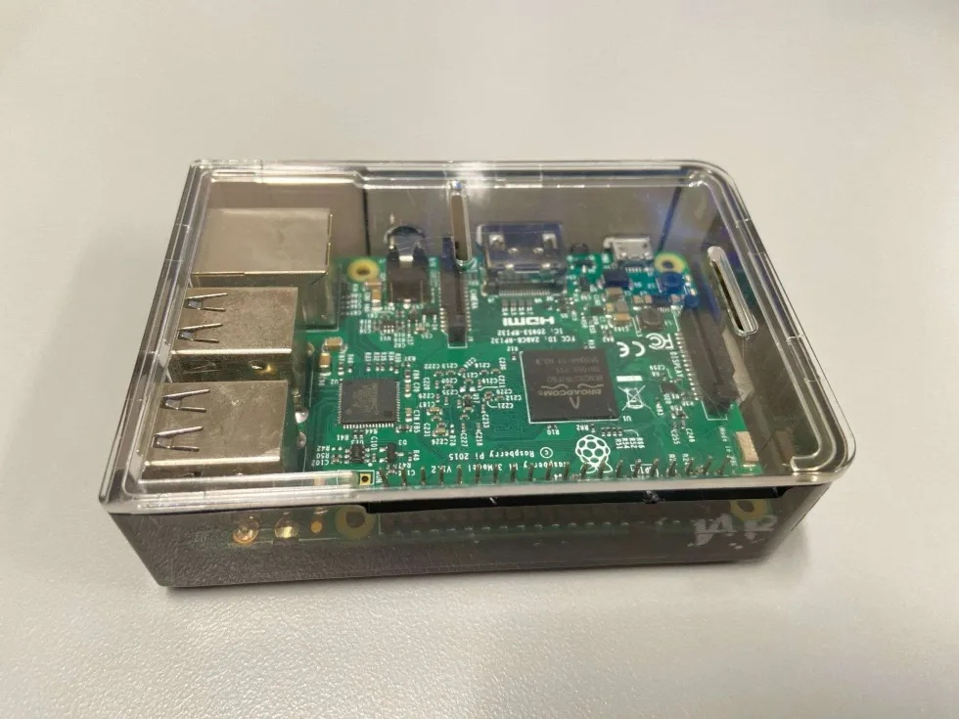
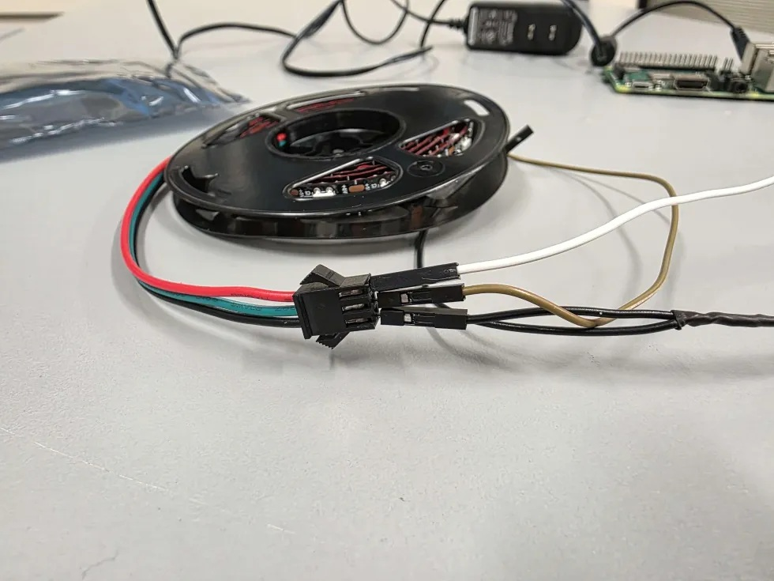
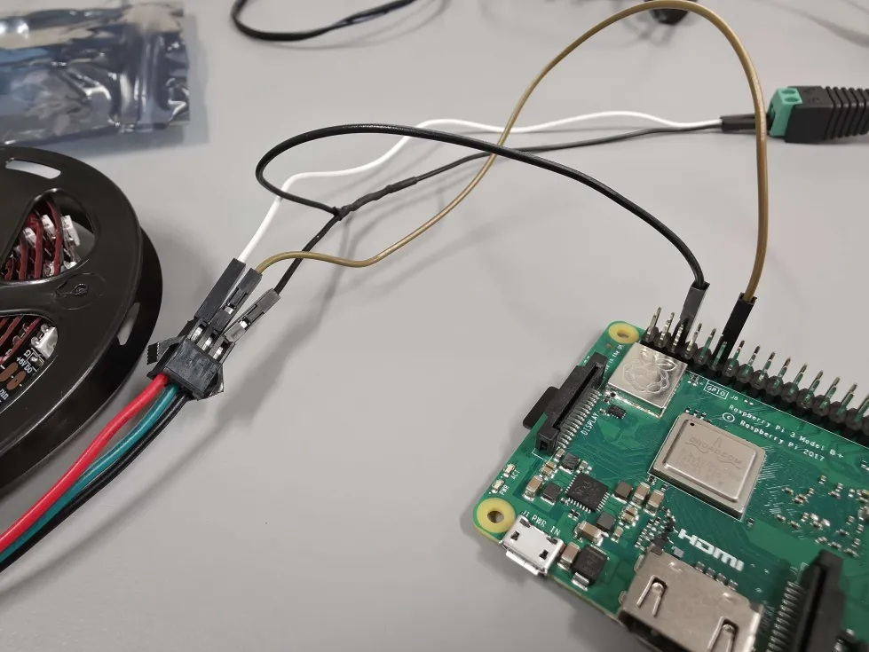
Setting up the Raspberry Pi
OS Version
Wiring The LED Strip
Connect wire to power supply
Make sure Raspberry Pi is compatible. Newer Raspberry Pi models will run into Compatibility issues. OS must be the legacy version known as Bullseye OS and running Python 3.9.2. You can check this inside Thonny.
LED strip must be wired from the female side, meaning the side where the pins will be inserted into the connector. Make sure The ground wire has the split wire.
(Split wire must be double male to single female. Shown in next picture)
LED strip needs an external power supply to turn on. A hot wire (+) and ground wire (-) must connect to the adapter. Screwdriver required.

Slide 9
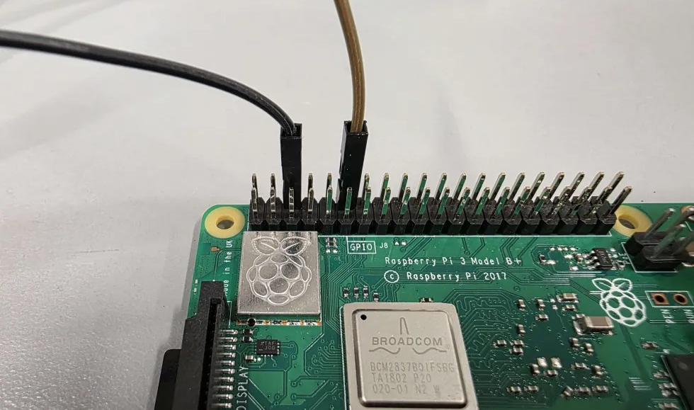
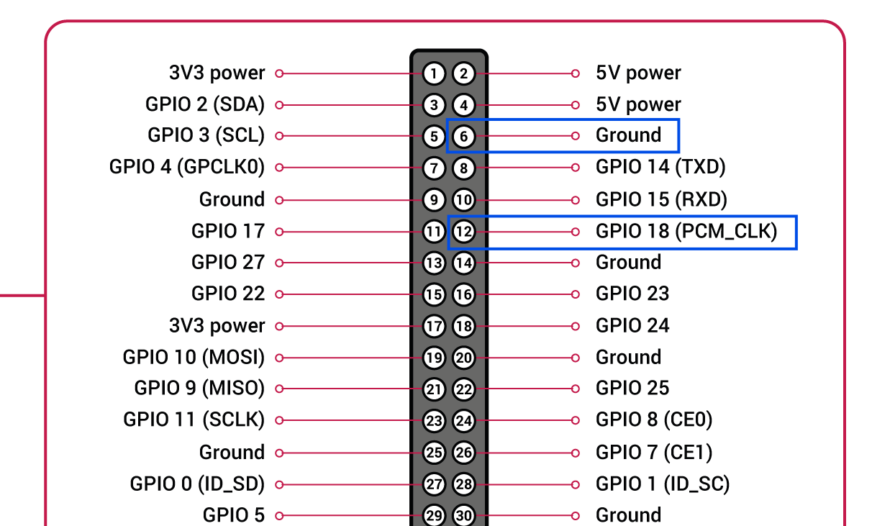
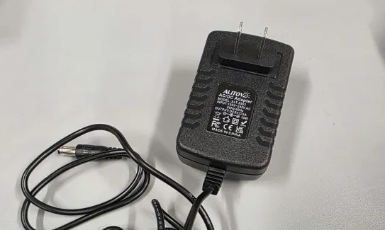
Setting Up the Raspberry Pi (Cont.)
Connecting to Pi
GPIO Layout
Power Supply
The Wires will need to also connect to the pi. This is where the split wire is required. The split wire is for the ground(-) wire and will connect to the third pin down on the right side. The Data wire will connect to the sixth pin down from the data wire.
To clarify, from the right side, there will be 2 open pins, then the ground wire, 2 more open pins and finally the data wire. The hot (+) wire does NOT connect to the Raspberry Pi.
A 5 volt Power supply with 3 amps is sufficient enough for a 60 pixel LED strip ("5v 3A"). Make sure it is plugged in!

Slide 10
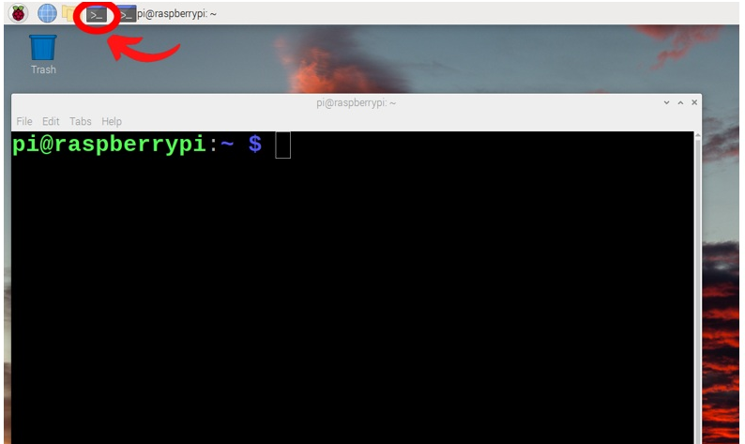
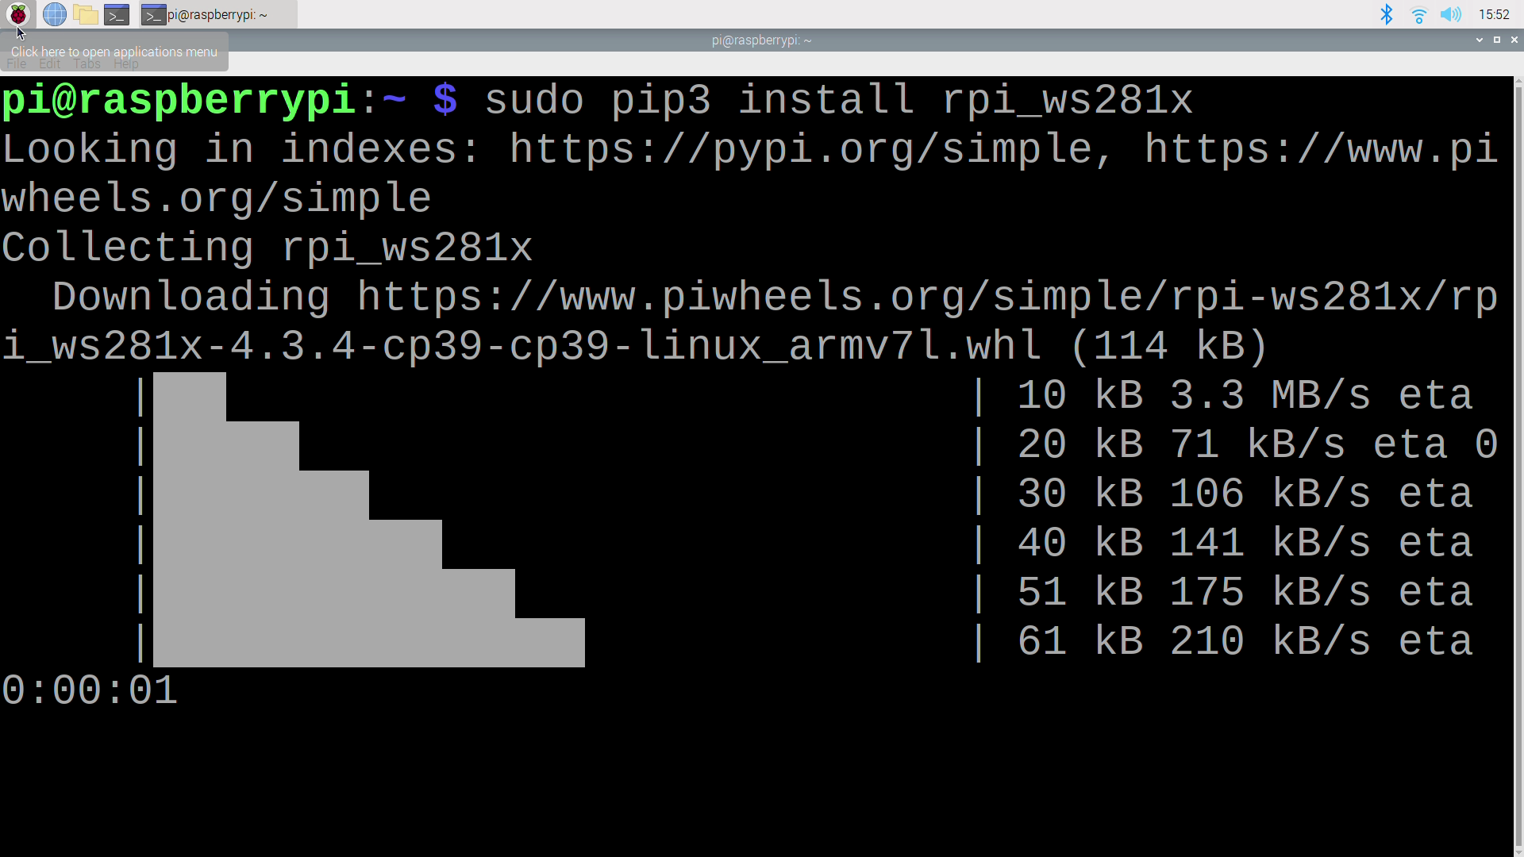

Setting up software
Open the Terminal
Download the Libraries
Be patient!
In the Raspberry Pi desktop open the terminal by clicking on the taskbar icon as shown in the picture above.
sudo pip3 install rpi_ws281x
sudo pip3 install adafruit-circuitpython-neopixel
sudo python3 -m pip install --force-reinstall adafruit-blinka
Copy and paste the lines in the terminal one by one. Wait for the process to finish completely before entering the next line.

Slide 11
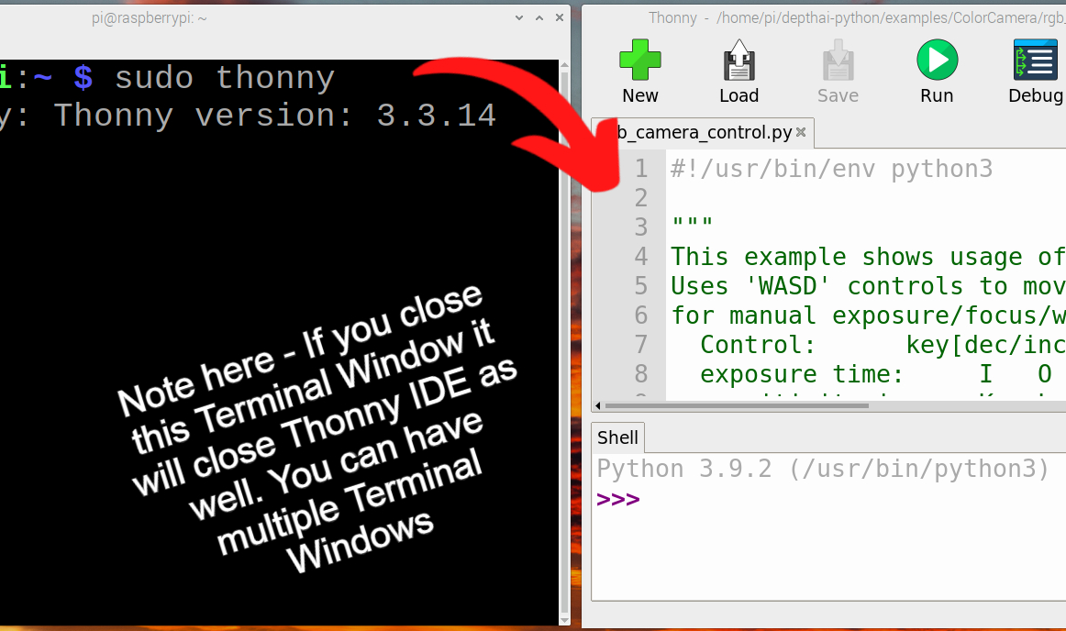
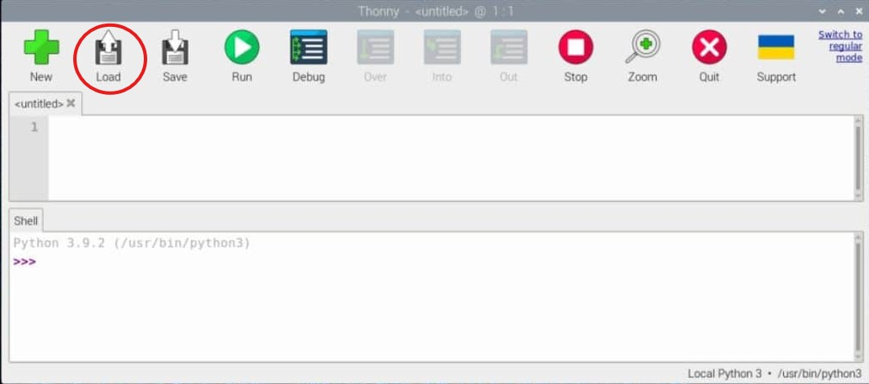
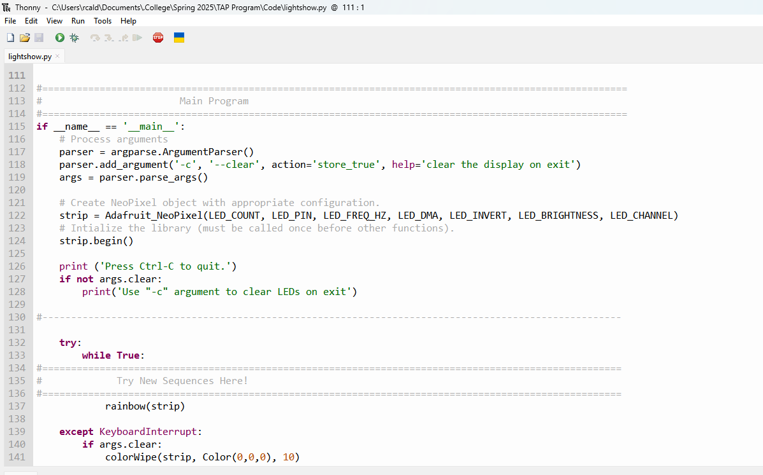
Using Thonny
Thonny Needs Root Permission
Load Code
Add your code!
Open the terminal in the Raspberry Pi and type "sudo thonny" without the quotes. If you close the terminal, Thonny will also close.
Click on the Load button in Thonny and look for the file called lightshow.py
Scroll down to where you see the comment "Enter your sequence here!" To add your code. Check the Cheat Sheet for Simple functions to use.

Slide 12
Please fill out our survey! It means a lot to us!
[placement for link or QR code]
We will appreciate your honest feedback!

Slide 13
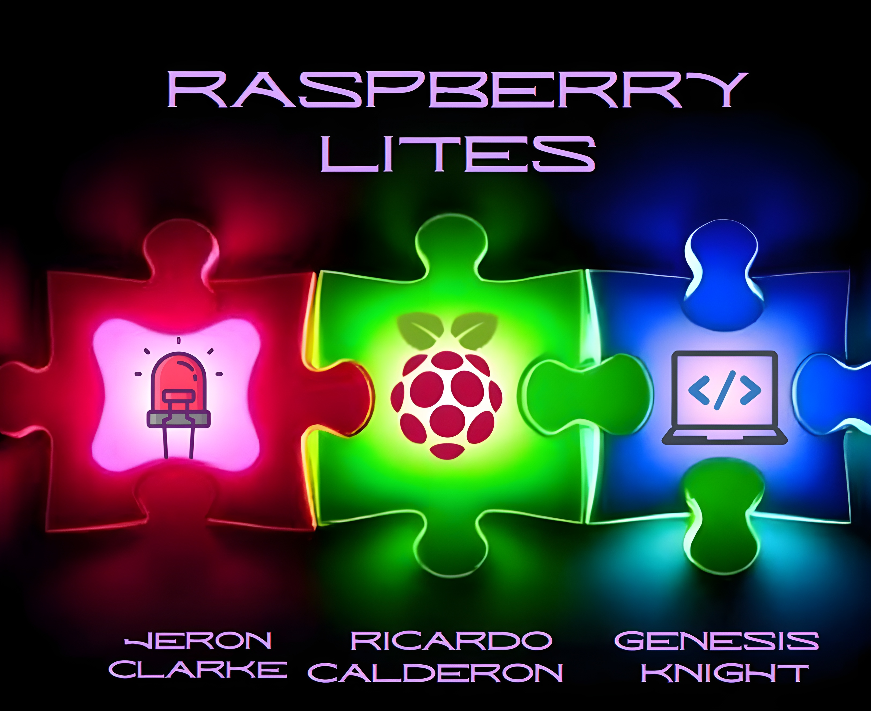
Thank you! :) Questions?

